Slide 1
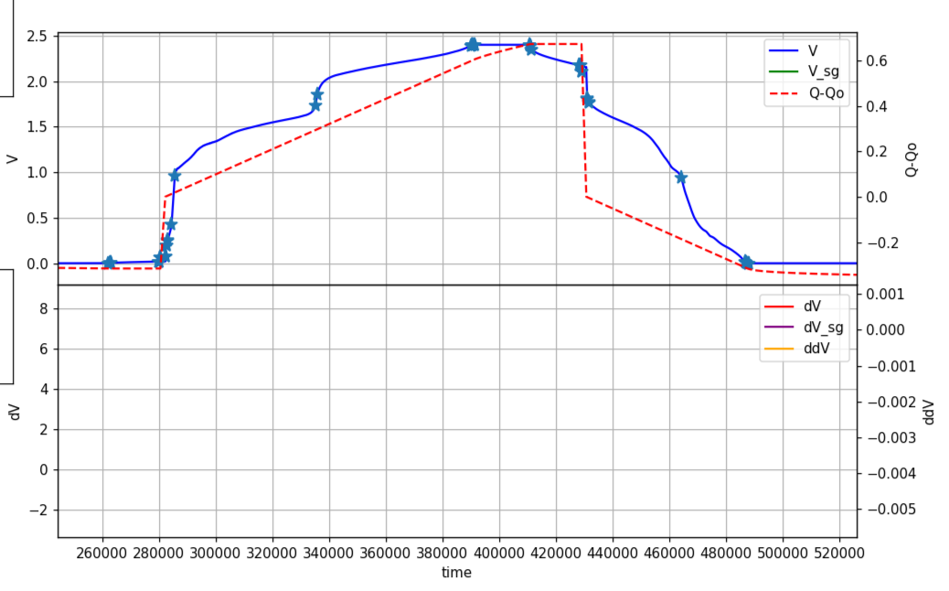
max V
max Q
EIS
EIS
V = 0
V = 0

